Slide 1

Project Presentation
on
LAB-G: New approach for Assessment
Presented by
Aman Ojha (1902840130008)
Misbah Uddin (1902840130014)
Fahad Bin Zafar (1902840130012)
Mohd. Alfahad(190284010015)
Under the Guidance
of
Mr. Ashish Dwivedi
(Assistant Professor)
Department of Information Technology
United Institute Of Technology (Prayagraj)
2022-2023
1 / 9

Slide 2
Table Of Content
Introduction Problem Statement Solution
Proposed SDLC Model
Interface
Algorithum used
Length Checker
Grammar Checker
System Requirements
Software Requirement
Hardware Requirement
Database Requirement
Design & Diagram

Slide 3
Activity Diagram
Block Diagram
Usecase Diagram
Conclusion
Future Scope
Project Interface
Login Interface
Register Interface
Student Interface
Test Cases
Accuracy Table
Reference

Slide 4
Introduction
Lab-G is an application used for assist the growth in lab performance by student. In this application faculty monitor the performance of a student and student can see their growth and monitor their lab performance . The app also provides graphical representation and provide prediction of student’s performance . Here predication means faculty members check student’s learning ability accordingly . We assist student on their assignment performance. It gives students first-hand experience and offers better opportunities for learning. Performing reliable examinations on research material delivered to the labs.

Slide 5
Problem Statement
Many genius individuals contributed to its development. But there’s one person who stands out when thinking about when ML was invented. Arthur Samuel, a computer scientist at IBM and a pioneer in AI and computer gaming, Machine learning al- gorithms automatically build a mathematical model using sample data – also known as “training data” – to make decisions without being specifically programmed to make those decisions.
Students are not paying attention to Lab lectures.
Student didn’t find an interactive way for showing their knowledge.
Faculty members are not sure about whether students are getting everything or not.

Slide 6
Solution
To show the lab performance of the individual student by checking their growth.
To check the Understandability level of the student.
It will be helpful for faculty member to assist the studentEasy to access student data.
Assessment reliability.
Solution for all student data storage of score.

Slide 7
Proposed SDLC Model
Iterative Waterfall Model:-
We are using Iterative Waterfall Model :
• The Iterative Waterfall Model is a method of software development that combines iterative design flexibility with the sequential processes of the conventional Waterfall Model.
• The primary distinction between the iterative waterfall model and the traditional waterfall model is the provision of feedback channels from each step to its predecessor phases.
• It is a good choice for small projects or teams who are new to software development because it is simple to comprehend and put into practice

Slide 8
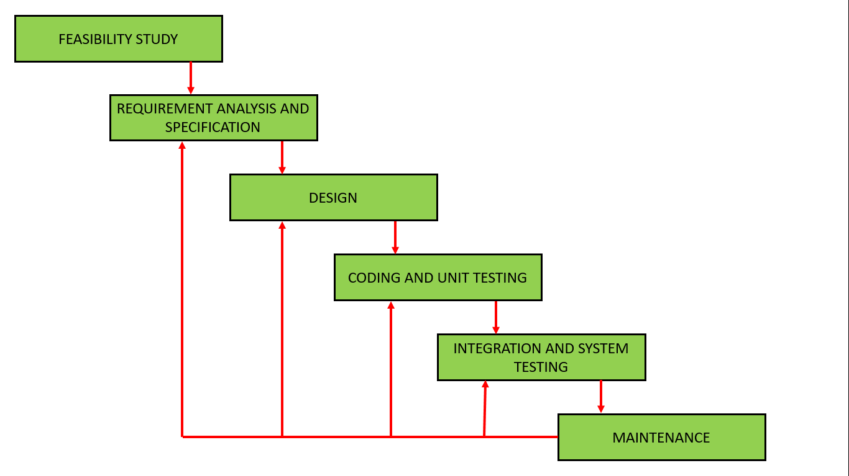
Iterative Waterfall Phases

Slide 9
Algorithum used
Grammarchecker
The automatic detection and correction of grammar, spelling, word order, and punctuation mistakes discovered in English text authored by non-native speakers of the language is a crucial part of natural language processing. Technology from computer programming is used for this.
Samplecode :
import languagetoolpython
Def GrammerChecker(solution):
mytool = languagetoolpython.LanguageTool( ′ en−US′)
matches = mytool.check(answer)
MyMistakes = []
For rules in matches:if len(rules.replacements)>0:
myMistakes.append(answer[rules.offset:rules.errorLength + rules.offset]) return len(myMistakes).
7 / 13

Slide 10
Keyword Checker:
Some grammar checker software have a feature called "keyword matching for marking" that enables teachers and instructors to grade student's writing based on a list of predetermined words or phrases.
SampleCode :def KeyWordmatching(X,Y_{l} st) def KeywordMatching(X,Y_list):
result=0
#Tokenizing X_list=word_tokenize(X)
#List for stopwords sw=stopwords.words(‘english’)
l1=[]
l2=[]
#remove stopwords from X_list
7 / 13

Slide 11
X_set={w for w in X_list if not w in sw}
#For Y_list for Y in Y_lst:
Y_list=word_tokenize(Y)
Y_set={w for w in Y_list if not w in sw}
#form a set containing both sets: rvector=X_set.union(Y_set)
#Preparing two vectors for cosine similarity for w in rvector:
if w in X_set:
l1.append(1)
else:
l1.append(0)
if w in Y_set:
l2.append(1)
else:
l2.append(0)
c=0

Slide 12
#using cosine formula for similarity
for i in range(len(rvector)): c+=l1[i]*l2[i]
#formula
#c/sqrt(sum(l1)*sum(l2))
#Using mathematical equation cosine=c/float((sum(l1)*sum(l2))**0.5)
cosine=cosine*100
result += cosine
cosine=result/3
if cosine>90:return 1
if cosine>80: return 2
if cosine>60: return 3
if cosine>40: return 4
if cosine >20: return 5
return 6

Slide 13
Similarity checking
class AnsSim:
def__init__(self,w2v_model,stopwords=None):
self.w2v=w2v_model
self.sw=stopwords if stopwords is not None []
def vectorize(self,ans:str) -> np.ndarray:
#Identify vector values for each word in the given Answer
#Param Ans
#return result
ans=ans.lower()
words=[w for w in ans.split(“ “) if w not in self.sw]
word_vcts=[]
for word in words:
try:

Slide 14
v=self.w2v[word]
word_vcts.append(v)
except:
#Ignore if word does not exist in the vocabulary
vct = np.mean(words_vcts,axis=0)
return vct
def _cosine_sim(self,vecA,vecB):
#computing the cosine distance between two vectors
c=np.dot(vecA,vecB)/
(np.linalg.norm(vecA)*np.linalg.norm(vecB))
if np.isnan(np.sum(c)):return 0
return c
def cal_sim(self,srcAns ,
tarAns=None,threshold=0):
#compute & revert similarity scores between given source answer & target answer

Slide 15
if not tarAns:
return []
if isInstance(tarAns,str):
tarAns=[tarAns]
src_vec=self.vectorize(srcAns)
results=[]
result=[]
for s in tarAns:
tar_vec=self.vectorize(s)
s_score=self._cosine_sim( src_vec,tar_vec) result.append(s_score)
if s_score > threshold:
$we can remove this
{results.append( {“score}:s_score,”ans”:s)
results.sort( key=lambda k:k[“score”] ,reverse=True)}
return result

Slide 16
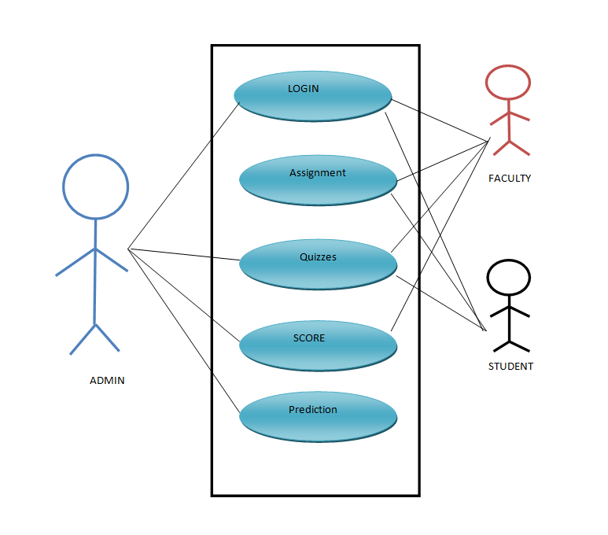
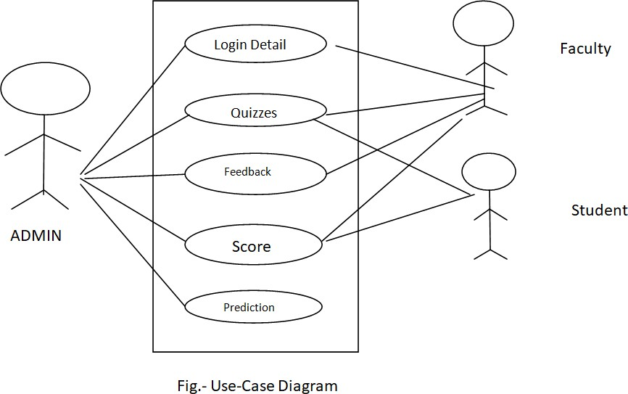
Design & Diagram
Use Case Diagram
9 / 13

Slide 17
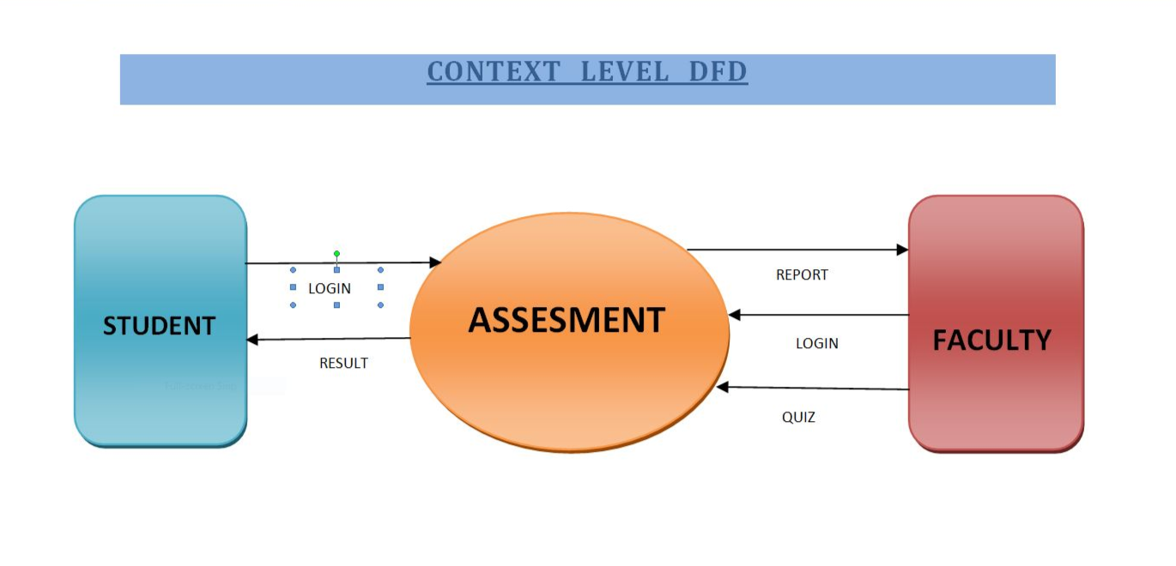
DFD-Level-0

Slide 18
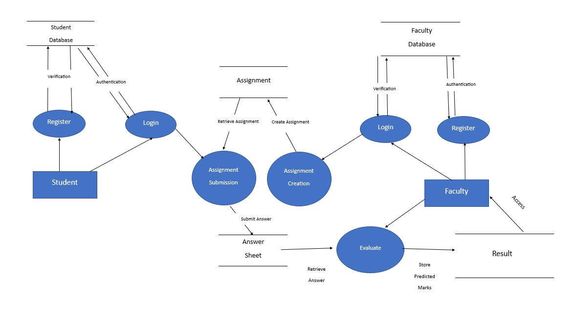
DFD-Level-1

Slide 19
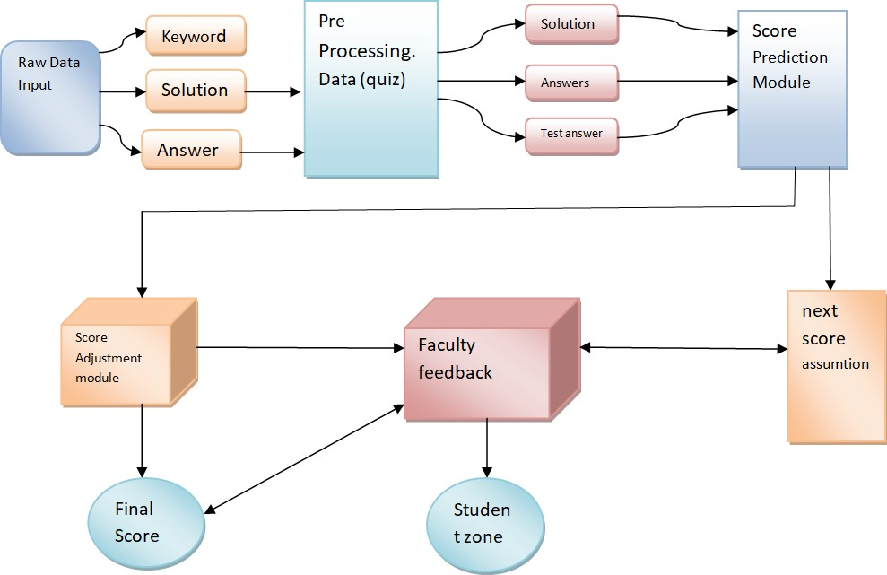
Block Diagram
11 / 13

Slide 20
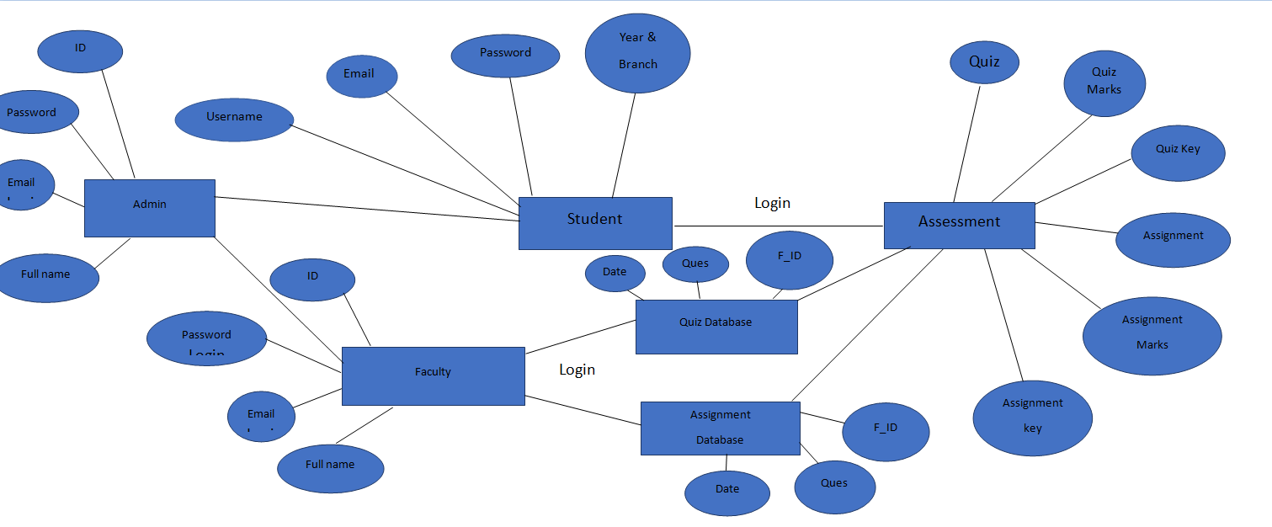
Relational Diagram
ad.jpeg
10 / 13

Slide 21
System Requirement
Software Requirement
• Node.js
• Python
• MONGO
Hardware Requirement
• CPU: Intel i5 or higher
• Memory: 8 GB RAM
• Free storage: 8 GB

Slide 22
Conclusion
We believe to have provided an interesting and necessary first-look at a fast-growing online platform that became an
unexpected player in the complex political atmosphere of 2017, joining the ranks of the established platforms such as Twitter (with its Russian bots problem) or Facebook (with its fake news problem). There is always a room for improvements in any apps. Right now, we are just dealing with text communication. There are several chat apps which serve similar purpose as this project, but these apps were rather difficult 15 to use and provide confusing interfaces. A positive first impression is essential in human relationship as well as in human computer interaction.
This project hopes to develop a chat service Web app with high quality user interface. In future we may be extended to include features.
12 / 13

Slide 23
Future Work
In schools, assessments serve two goals. Each exam provides an opportunity for the students to demonstrate what they have learned, get feedback on their errors, and enhance their performance. Teachers can use it as a fantastic tool to evaluate the efficacy of their preferred method 51 of instruction. What does assessment mean in terms of education? Information is gathered from a variety of sources during an assessment to determine the student’s level of understanding and expertise. By going over and examining this data in its context, it could be feasible to establish what worked and what didn’t.What function does assessment serve? user can good understand their errors or feedback they got through evaluations. feedback could also shown an another chance to adapte the knowledge and again the test to shown better.

Slide 24
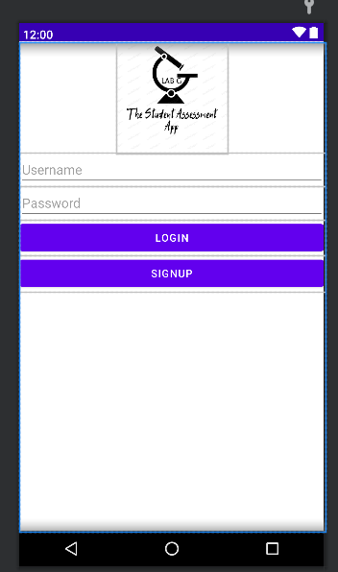
Project Interface
Login Interface

Slide 25
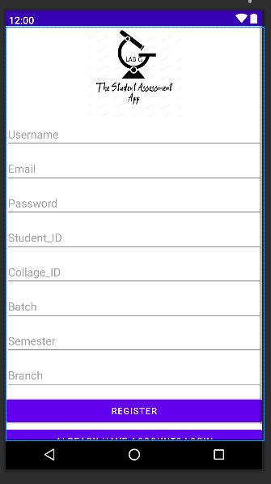
Register Interface

Slide 26
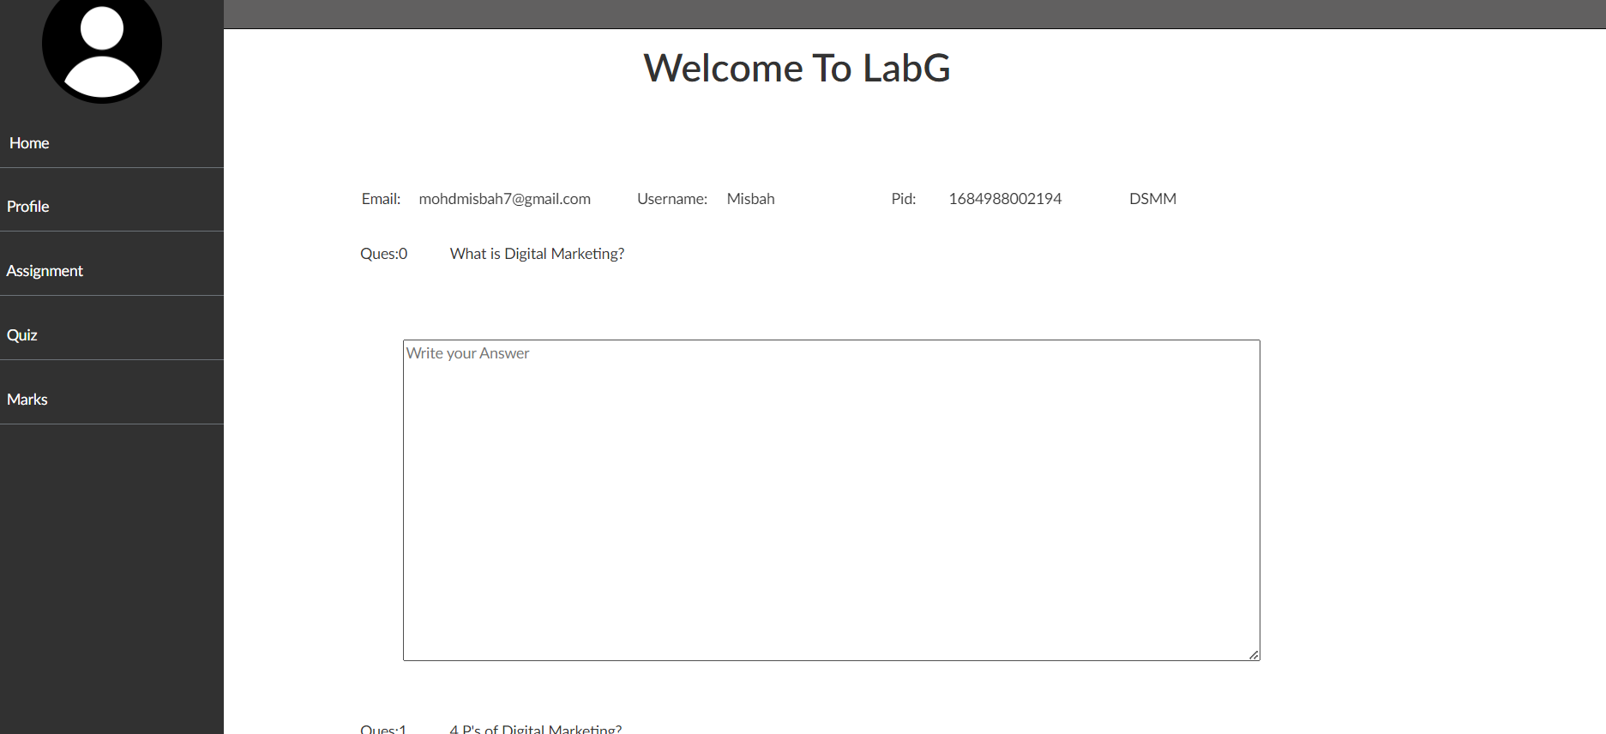
Student Interface

Slide 27
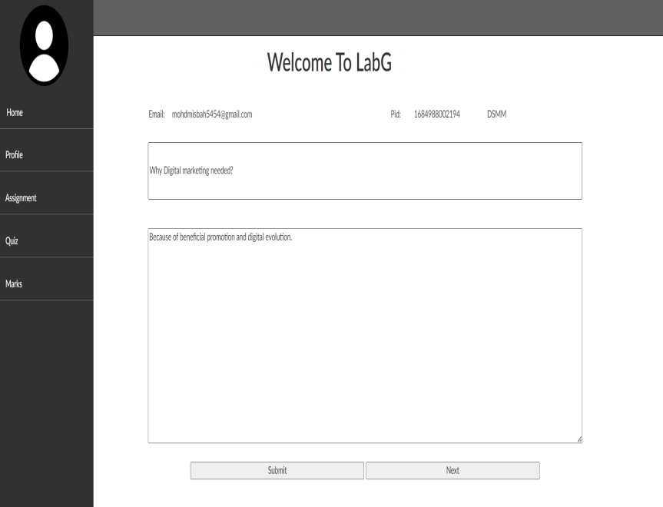
Faculty Interface

Slide 28
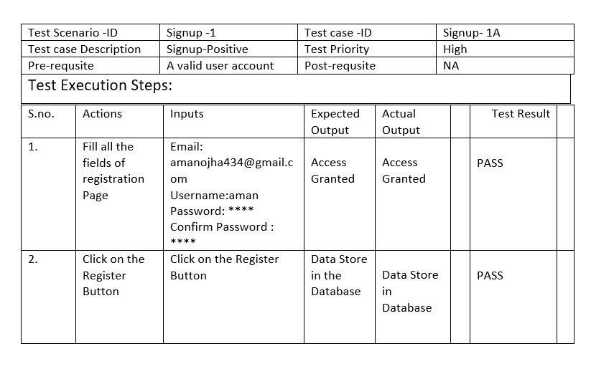
Test Cases
Signup Positive

Slide 29
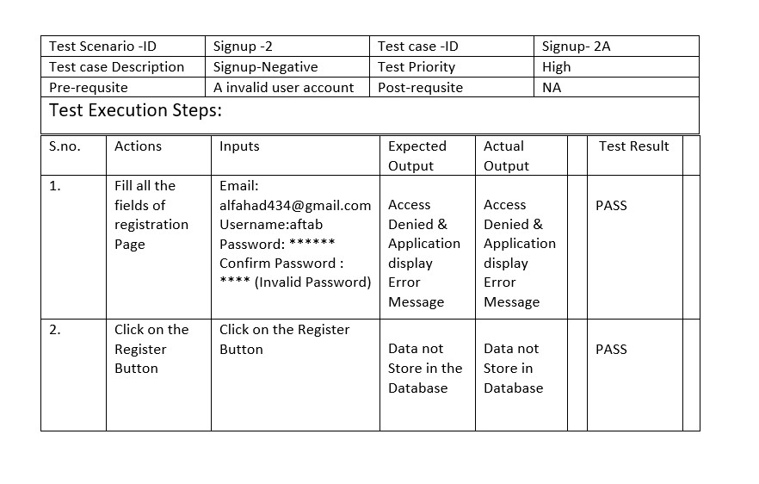
Signup Negative

Slide 30
PRECISE RESULT
Acuracy Table :
Test No. | Actual Score | Predicted score | Accuracy
1. | 20\100 | 20\20 | 100%
2. | 06\20 | 04\20 | 60%
3. | 10\20 | 08/20 | 80%

Slide 31
Overall Accuracy- 82.5%
Description: Test no. is the serial number of tests given by our college ,and the actual score is the score gien by the faculty member which we compare with our module predicted score and we get overall 82.5% accuracy.

Slide 32
Reference
J. Wang and Y. Dong, “Measurement of text similarity: A survey,” Inf., vol. 11, no. 9, p. 421, 2020.
M. Han, X. Zhang, X. Yuan, J. Jiang, W. Yun, and C. Gao, “A survey on the techniques, applications, and performance of short text semantic similarity,” Concurr. Comput. Pract. Exp., vol. 33, no. 5, 2021.
M. S. M. Patil and M. S. Patil, “Evaluating student descriptive answers using natural language processing,” International Journal of Engineering Research & Technology (IJERT), vol. 3, no. 3, pp. 1716–1718, 2014.
P. Patil, S. Patil, V. Miniyar, and A. Bandal, “Subjective answer evaluation using machine learning,” International Journal of Pure and Applied Mathematics, vol. 118, no. 24, pp. 1–13, 2018
13 / 13

Slide 33
5. Zhang L, et al. Using linguistic features to estimate suicide probability of Chinese microblog users. In: International conference on human centered computing. Berlin: Springer;
6. H. Mittal and M. S. Devi, “Subjective evaluation: A comparison of several statistical techniques,” Appl. Artif. Intell., vol. 32, no. 1, pp. 85–95, 2018.
7. L. A. Cutrone and M. Chang, “Automarking: Automatic assessment of open questions,” in ICALT 2010, 10th IEEE International Conference on Advanced Learning Technologies, Sousse, Tunisia, 5-7 July 2010, pp. 143–147, IEEE Computer Society, 2010.
8. G. SRIVASTAVA, P.K.R. MADDIKUNTA, and T. R. GADEKALLU, “A two-stage text feature selection algorithm for improving text classification,” 2021.

